Slide 1


World Bank Population Data Analysis Project

Slide 2
Objective
The project aims to address the complexity of global population dynamics by analyzing World Bank data.
it seeks to understand and explain deviations in population growth trends among countries
Investigate the factors influencing population dynamics in low-income and lower-middle-income nations, and explore the disparities in population distribution across regions and income groups over time (1960 to 2022).
This research aims to identify key challenges and opportunities, providing a foundation for informed policy interventions and targeted strategies to address the diverse demographic patterns observed on a global scale.

Slide 3
Data Collection
The project utilizes three Kaggle-sourced CSV files: "countries.csv" contains detailed country-specific information, "region_and_income.csv" classifies countries by region and income group, and "metadata.csv" offers supplementary details.
These datasets were chosen for their reliability and completeness. The project aims to derive insights into global population trends, emphasizing regional and income group dynamics for informed decision-making.

Slide 4
Main Challenges
The data analysis encountered several challenges, primarily stemming from the structure and volume of the dataset. Notably, the "country" column contained overlapping information, including regions, income groups, and financial classifications.
The dataset's complexity was further heightened by the presence of over 60 columns spanning the years 1960 to 2022.
Identifying outliers in population data proved challenging due to inherent variability across countries. Instead, the analysis focused on assessing the growth trends over the extensive time span. To achieve this, z scores were employed across the year columns (1960 to 2022) to discern patterns and variations, acknowledging the genuine fluctuations in population data.
Navigating these challenges required a thoughtful approach to data preprocessing and analysis methodologies, ensuring meaningful insights were derived despite the intricacies of the dataset.

Slide 5
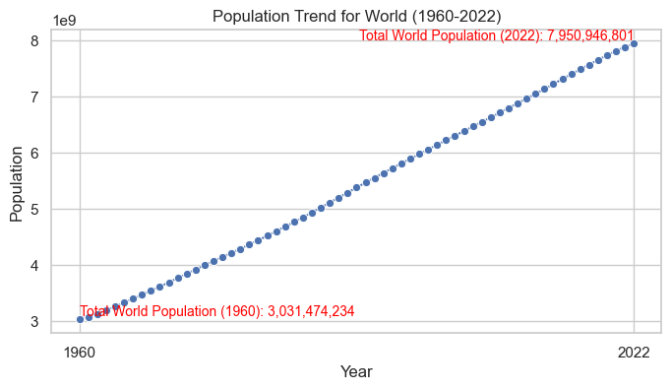
World Population Growth
While the world population is showing a linear growth rate overall, it's important to note that regional variations exist, and some countries may experience different growth patterns.
Additionally, unforeseen events, such as pandemics or geopolitical shifts, can impact population trends.
Continuous monitoring and understanding of demographic dynamics are crucial for informed policymaking and sustainable development.

Slide 6
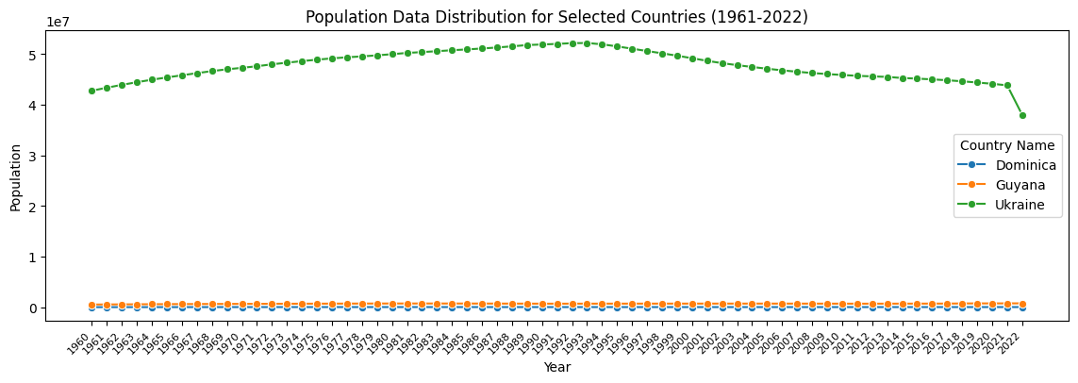
Identifying Population Growth Anomalies
Guyana, Dominica and Ukraine are the countries with growth anomalies
The countries displaying anomalous growth patterns were successfully identified through the use of z scores.
Employing z scores across the year columns from 1960 to 2022 allowed for a quantitative assessment of deviations from the overall population growth trends.
This statistical approach proved instrumental in pinpointing specific countries that exhibited significant anomalies

Slide 7
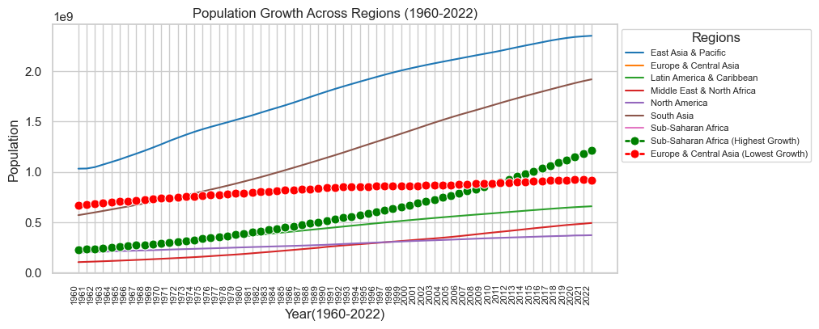
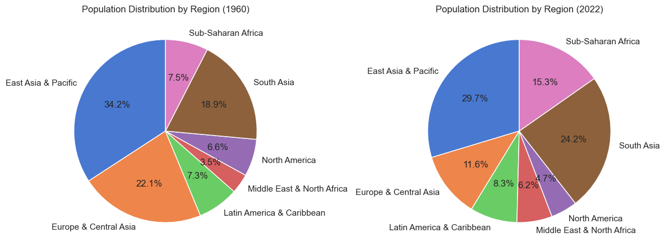
Regional Growth Contrasts and Global Population Redistribution
Regional Growth Trends: Sub-Saharan Africa exhibits the highest growth, while Europe and Central Asia show the lowest.
Population Distribution Shift (1960 vs. 2022): In 1960, East Asia and Pacific, Europe, and Central Asia held over 50%. By 2022, Europe and Central Asia contracted, and South Asia replaced it, reflecting a significant shift in global population distribution.

Slide 8
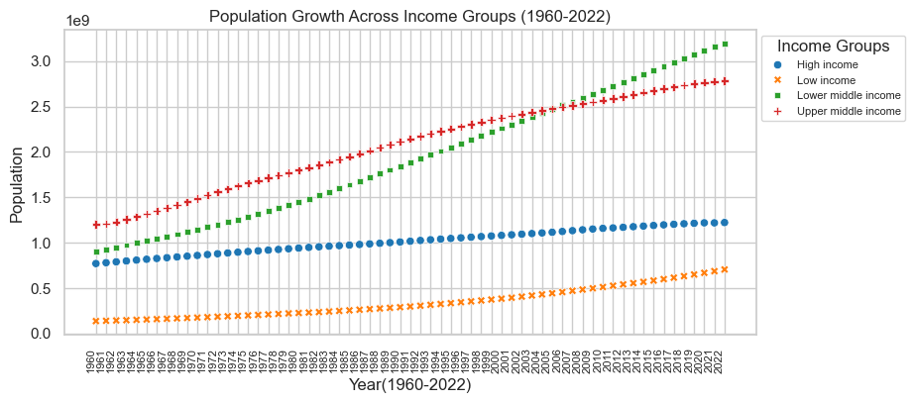
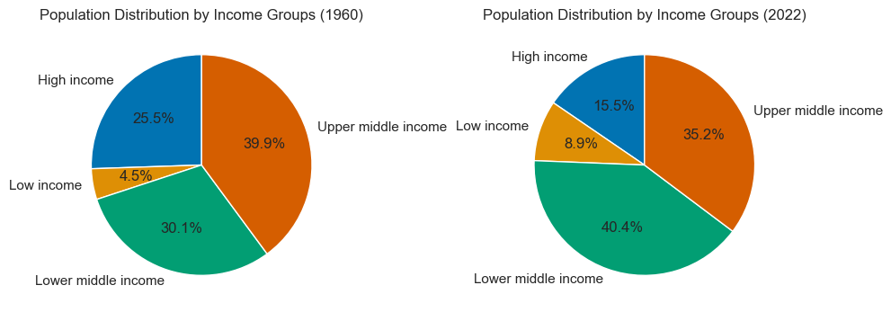
Shifting Proportions in Global Income Groups (1960-2022)
Rising Low and Lower Middle Income Proportions: Both Low and Lower Middle Income groups show significant population increases.
'Low Income' Dominates Growth: 'Low Income' group exhibits the highest growth at 418.35% from 1960 to 2022.
Contrasting Growth Patterns: The line graph highlights consistently higher growth in Lower Middle Income compared to other groups.
Subdued Growth in 'High Income' Group: 'High Income' group demonstrates the lowest growth at 58.71% over the same period.

Slide 9
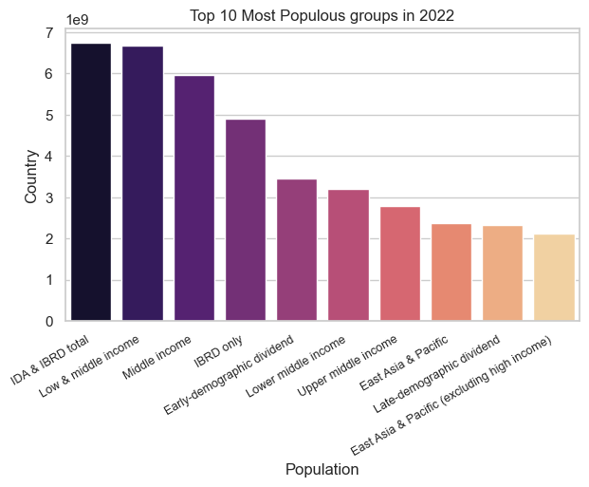
Population Peaks
The total population of member countries affiliated with the International Development Association (IDA) and the International Bank for Reconstruction and Development (IBRD) surpasses that of other groups.
It underscores the importance of these entities in shaping global population dynamics, emphasizing their substantial representation and impact on the overall demographic landscape.

Slide 10
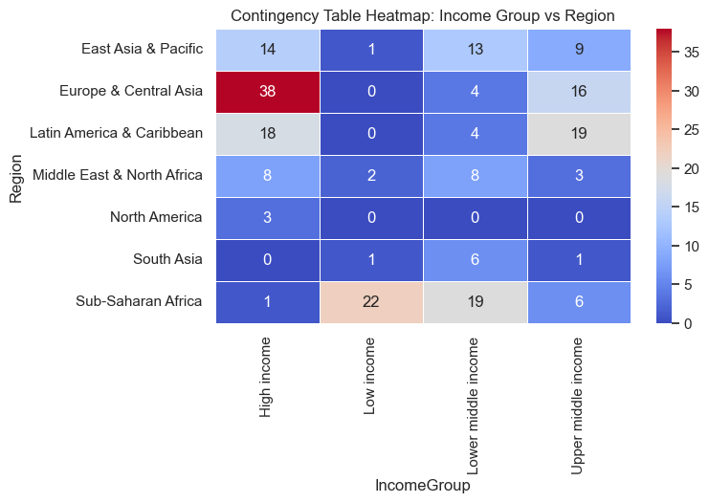
Regional Contrasts in High and Low-Income Countries
The heat map reveals distinct regional income patterns: Europe and Central Asia host the highest number of High Income countries, while South Asia lacks such nations.
Sub-Saharan Africa predominantly comprises Low Income countries, showcasing diverse economic landscapes across regions.

Slide 11
Possible Reasons Behind Population Growth Variations
The population growth in low-income and lower-income countries may be on account of various reasons like Economic challenges and poverty which contribute to a lack of access to family planning resources and healthcare, resulting in higher population growth, Agricultural Practices in many low-income countries, where agriculture is a significant part of the economy, larger families may be seen as an asset for farm labor, Cultural and socioeconomic factors influencing high fertility rates in low-income countries may contribute to population growth.
A stagnant or slower population growth in high income countries could be because of better access to family planning, education and career opportunities for women often correlate with delayed marriages and childbearing, government policies like Some high-income countries implement policies that support work-life balance, family planning, and parental leave
Both IBRD and IDA have a broad membership base, encompassing countries from various regions and income levels. The combined membership contributes to a larger overall population within these groups. The IDA provides concessional financing and the IBRD focuses on middle income countries which often have large populations

Slide 12
Conclusion
In summary, the World Bank population data analysis reveals a global linear growth trend, with Sub-Saharan Africa experiencing the highest population growth and Europe and Central Asia the lowest. Noteworthy are the anomalies among countries like Dominica, Ukraine and Guyana and the elevated growth rates in low-income and lower-middle-income nations.
The IDA and IBRD population group stands out as the most populous. Additionally, the comparison of population distribution proportions in 2022 and 1960 provides valuable historical context, emphasizing the need for nuanced interventions to address the diverse challenges posed by global population dynamics.

